Slide 1
Verifying Hardware Security Modules with Information-Preserving Refinement
papers for reading group
Cunhan You
2023/3/3
Anish Athalye, M. Frans Kaashoek, Nickolai Zeldovich
MIT CSAIL
OSDI22

Slide 2
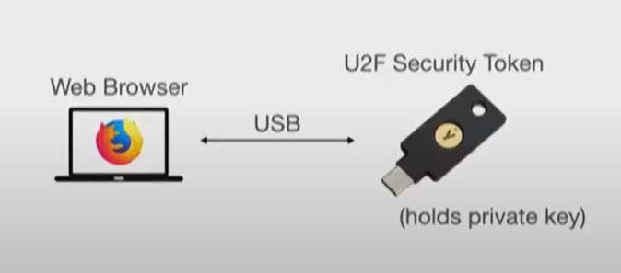
HSMs: powerful tools for securing system
Factor out core security operations
Provide security under host compromise
Many types of HSMs
  U2F token
  PKCS#11
  Hardware wallet
  iPhone Secure Enclave
Hundreds of millions of deployed HSMs

Slide 3
HSMs suffer from bugs
Hardware
Software
Timing side channels

Slide 4
Goal: HSMs without security vulnerabilities
Rule out hardware, software, and timing side-channel vulnerabilities
Threat model
  Powerful adversary that gains control of host machine
  Full control over I/O interface to HSM
  Physical attacks and other side channels: out of scope

Slide 5
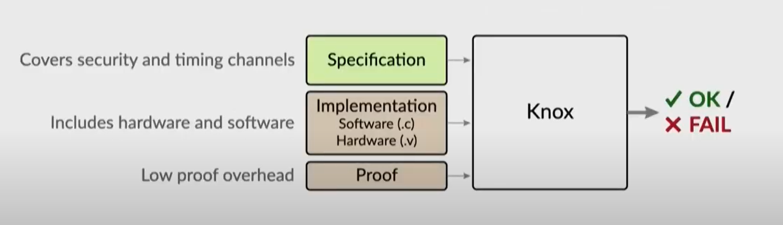
Approach: formal verification

Slide 6
Related work
Knox is the first to verify correctness and security of hardware and software including timing side channels
Hardware/software co-verification: Bedrock2 [PLDI'21], CakeML [PLDI'19]
  Focused on correctness, not security
Application security verification: lronclad Apps [OSDI'14]
  Doesn't cover hardware or side channels

Slide 7
Contributions
Information-preserving refinement (IPR)
  a new security definition
Knox framework
  for verifying HSMs using IPR
Case studies
  built and verified 3 simple HSMs
    PIN-protected backup HSM
    Password-hashing HSM
    TOTP token
Approach rules out hardware bugs, software bugs, and timing side channels

Slide 8
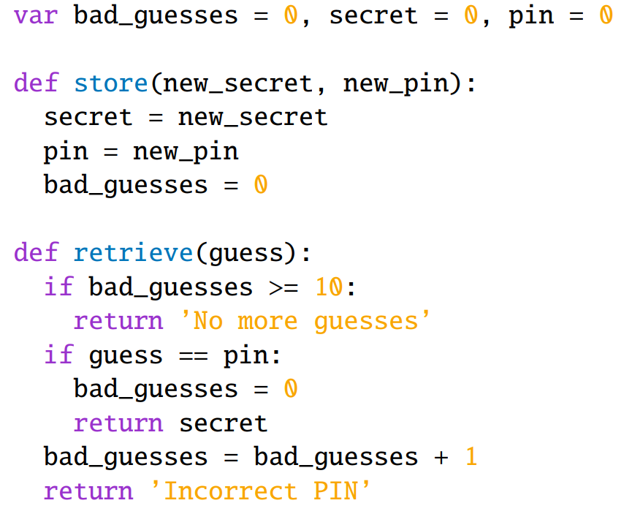
Example: PIN-protected backup HSM
Functional specification
Describes input-output behavior
  No notion of timing

Slide 9
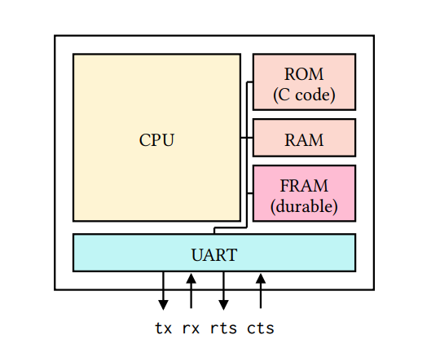
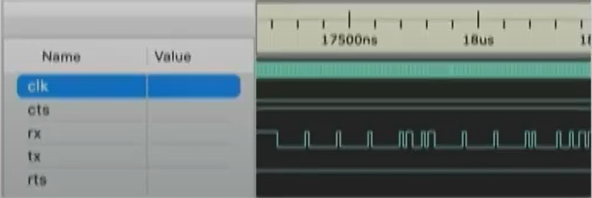
Implementation
lmplementation includes hardware/software
  CPU
  Code that runs on it
  Peripherals
  Persistent memory
  ...
Interface: wires
  Read output wires
  Write input wires
  Wait for a cycle

Slide 10
How to relate impl to spec
Want to capture:
  (1) Functional correctness: implementation implements spec
  (2) Non-leakage: Wire-level interface leaks no more than specIncluding timing, e.g., PIN comparison with strcmp()
lmplementation is at the level of wires
Specification is at the level of functions (has no notion of wires)

Slide 11
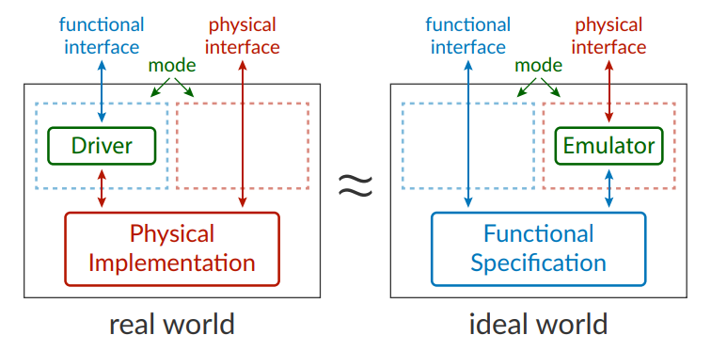
Information-preserving refinement (IPR)
Defined as indistinguishability between a real and an ideal world
Inspired by formalization of zero knowledge in cryptography
Interface adapters in each direction

Slide 12
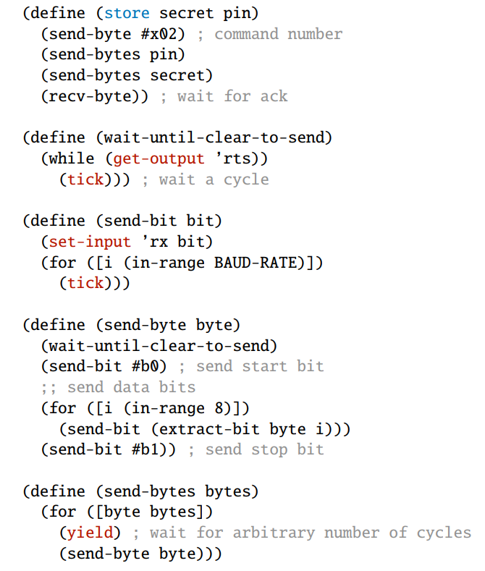
IPR: driver
Driver: translates spec-level operations to wire-level I/0
Like a device driver in an OS
Trusted, part of the specification
Captures functional correctness

Slide 13
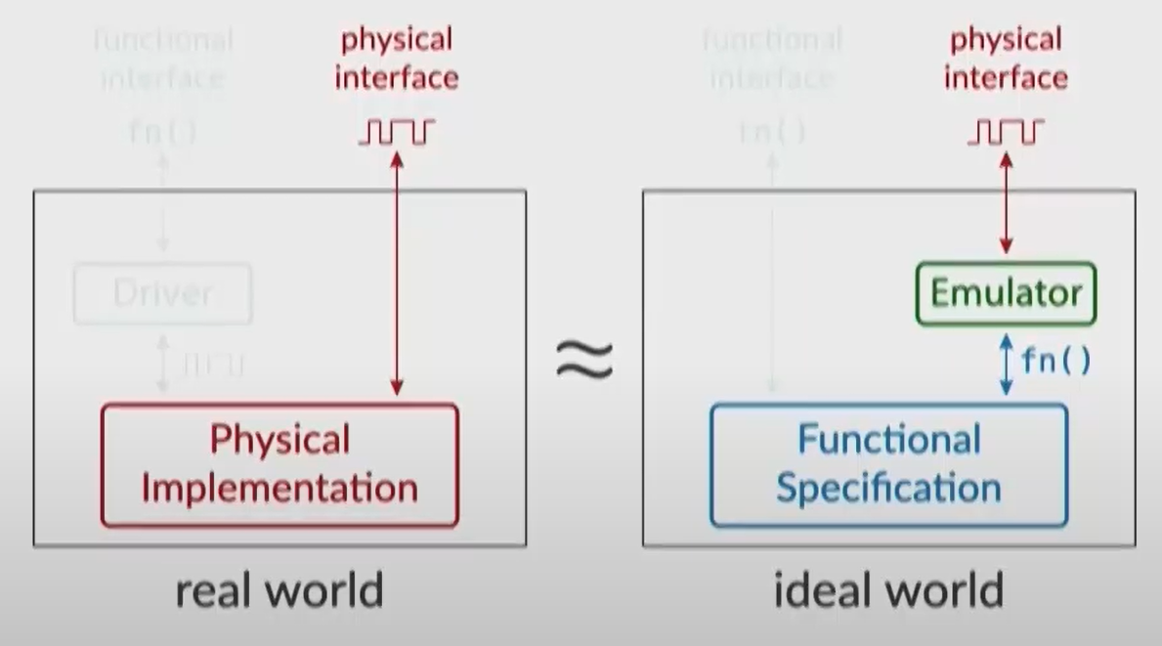
IPR: emulator
Emulator mimics wire-level behavior
  Without direct access to secrets
  With queries to spec-level operations
Proof artifact, constructed by developer(just needs to exist)
Captures non-leakage

Slide 14
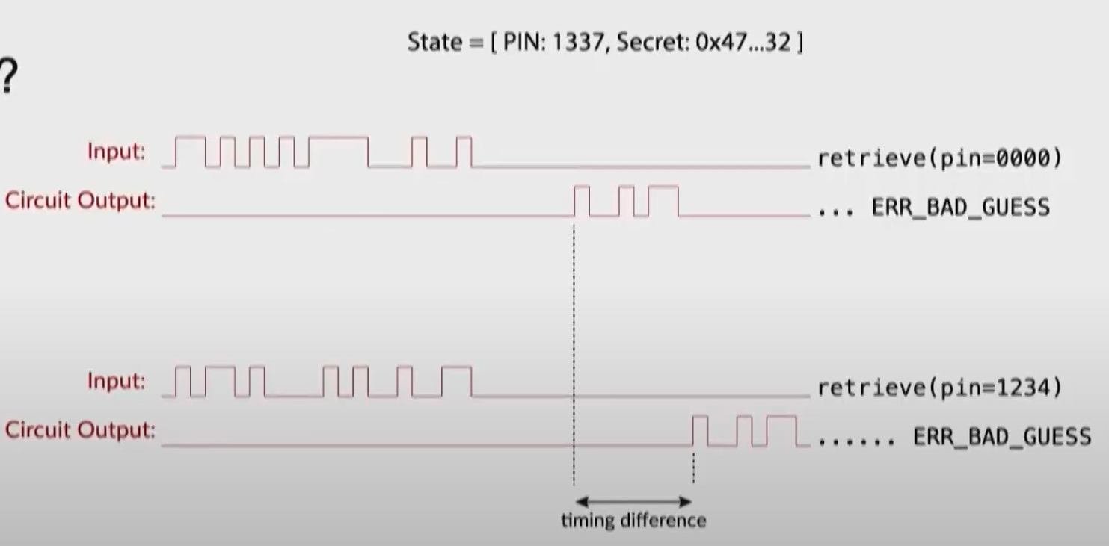
IPR rules out timing channels
What if circuit leaked info through timing, e.g., strcmp()?
Emulator does not exist: can get return value using query to retrieve(), but can't reproduce timing behavior

Slide 15
IPR: emulator construction
Copy circuit, but replace operations on secret state with queries to spec

Slide 16
IPR transfers security properties from spec
Only reveals secret when correct PIN supplied
Enforces guess limits
Forgets old secret/pin when store() is called
Doesn't leak past PIN guesses

Slide 17
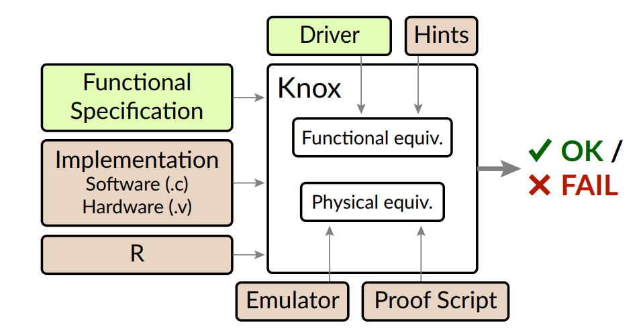
Knox framework
~3000 LOC on top of Rosette [PLDI'14]
Symbolically execute entire circuit + code
Relies on human guidance through hints
=Trusted
=Verified

Slide 18
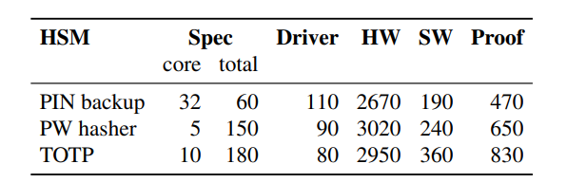
Evaluation: case studies
3 simple HSMs, run on an FPGA
Hardware: minimal RISC-V CPU, cryptographic accelerator, UART, ...
Software: control logic, peripheral drivers, HOTP, HMAC, …
Succinct specifications
Low proof overhead
Lines of code for case studies

Slide 19
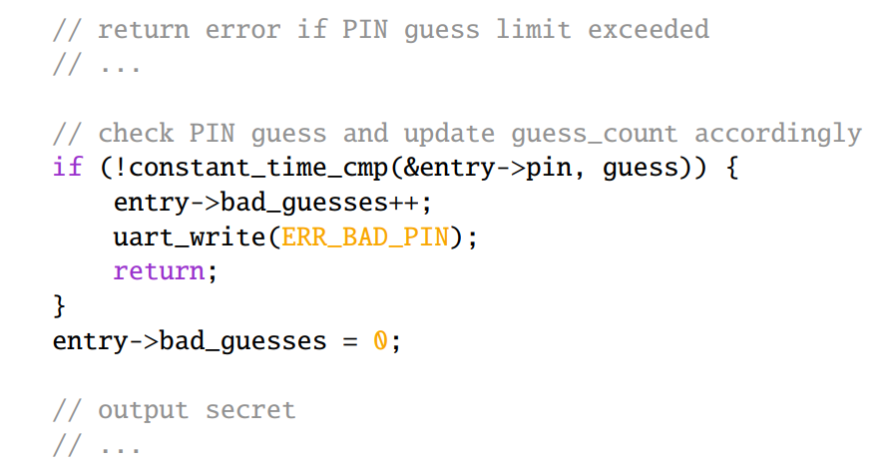
Subtle bug involving persistence & timing
retrieve
guess PIN=0000, PIN=0001
guess is correct
guess is incorrect
bad_guess = 0
force device reset
bad_guess++
Adversary can't tell which branch was taken
(no outputs up to this point) but still, security bug!
Resets guess count to 0

Slide 20
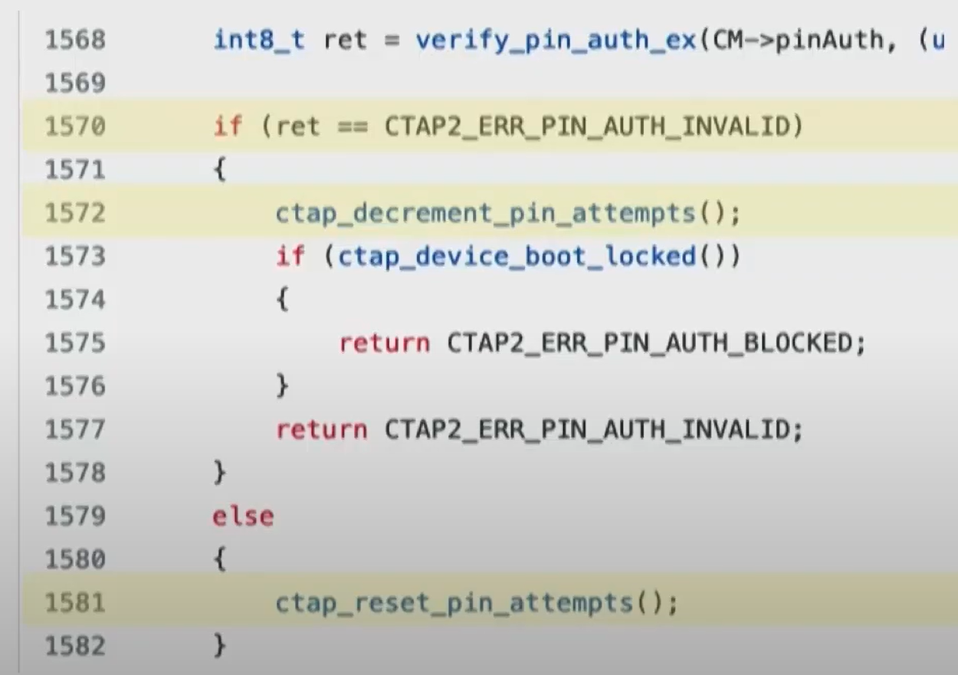
Real implementations have similar code
SoloKey: pattern similar to the bug
Other HSMs like OpenSK have more robust code to avoid this issue

Slide 21
Conclusion
Information-preserving refinement (IPR)
  lmplementation reveals no more information than specification
Knox framework
  For verifying HSMs using IPR
Case studies
  Built and verified 3 simple HSMs
anish.io/knox

